Slide 1
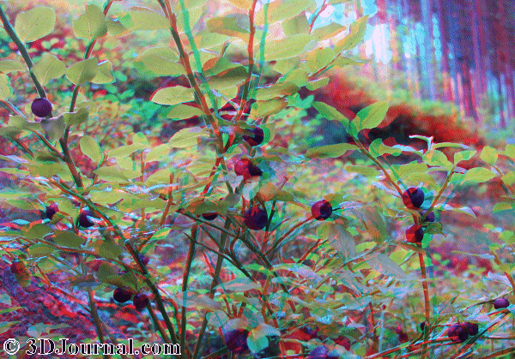
DIFFERENT LANDFORMS
BY: OSCAR &ANDRIALIN

Slide 2
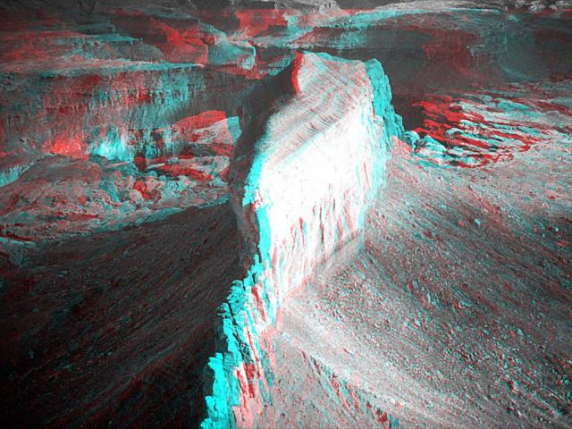
CANYON #1
A CANYON IS ONE OF THE LANDFORMS. MOST CANYONS ARE MADE BY ROCKS WHEN THEY COME TUMBULING DOWN.

Slide 3
HILLS # 2 THIS IS ALSO A LANDFORM. THESE ARE CREATED BY ROCKS THAT ARE STORD UNDER THE HILL AND OVER TIME GRASS BEGINS TO GROW AND BECOMES LAND.

Slide 4
MOUNTAIN # 3 THIS MOUNTAIN IS MADE BY PILES OF ROCK THAT GET PILED UNTILL IT IS HIGH ENOUGH. THEN TREES AND MAMALS START LIVING IN THEIR CAVES

Slide 5
WATERFALL # 4 MOST WATERFALLS ARE MADE BY ROCK THAT TRAPS WATER INSIDE THE ROCK. BEFORE IT TURNS INTO A WATERFALL IT IS A LAKE. SOON THE WATER IS TAKING SOME ROCKS AND WHEN THE PATH WAY IS CLEARED IT IS SOON A WATERFALL.

Slide 6
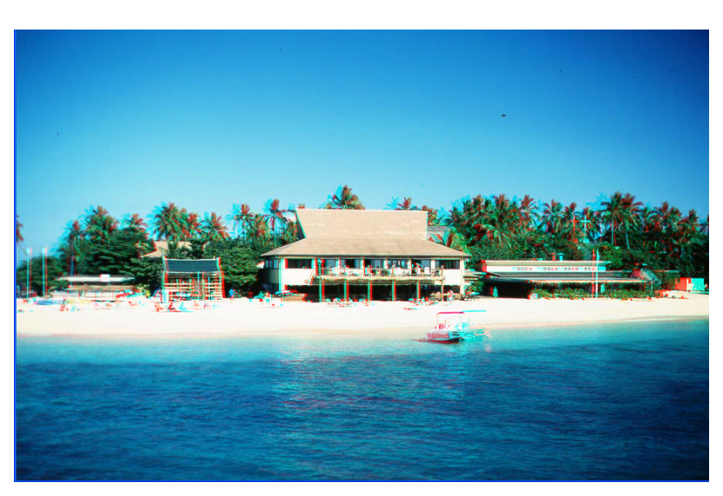
ISLAND # 5 AN ISLAND IS A ROCK THAT PILES UP AND GROWS PLANTS

Slide 7
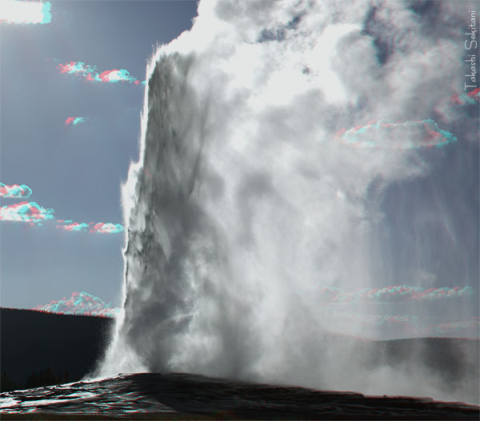
GEYSES # 6
MOST OF THE TIME GEYSERS ARE MADE FROM HOT WATER. MAGMA HEATS UP THE WATER AND BEGINS TO BOIL THEN IT EXPLODES.

Slide 8
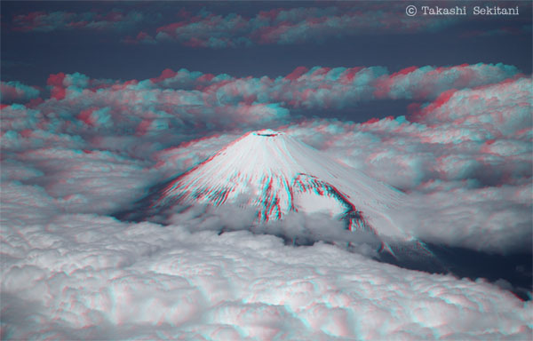
VOLCANO # 7
A VOLCANO IS A MOUNTAIN THAT HAS MAGMA IN OR UNDER

Slide 9
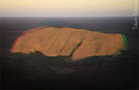
BUTTE # 9
A BUTTE IS A FLAT TOPPED MOUNTAIN. OVER TIME THIS MOUNTAIN SOMETIMES CHIPS ROCKS BY EROSION

Slide 10
THANKS FOR WATCHING
HORRAY

