Slide 1
Webquests
Essential Question:
How do WebQuests make student-centered, teacher-facilitated, inquiry-based learning possible?

Slide 2
The Goal:
“To create lessons that make good use of the web, engage learners in applying higher level thinking to authentic problems, and use everyone's time well”.
-------Bernie Dodge, PhD

Slide 3
Expected Outcomes
Teachers analyze WebQuests for classroom use to ensure they include high-quality tasks and inquiry-based learning.
After completing a WebQuest in the classroom teachers evaluate the effectiveness of the WebQuest in meeting the learning needs of their students.

Slide 4
What is A Webquest
WebQuest is an inquiry-oriented lesson format in which most or all the information that learners work with comes from the web. These can be created using various programs, including a simple word processing document that includes links to websites.
Webquest.org

Slide 5
What are WebQuests? They are…
Inquiry-based curriculum units
Student-created meaningful projects
Activities that engage students with achievable tasks
Higher Order Thinking Skills: creativity, analysis, synthesis, judgment, and problem solving

Slide 6
The Goal:
We must become connoisseurs of fine student performance! --Bernie Dodge

Slide 7
Transforming Education
Create
Motivate
Stimulate
Solve
Explore
Design
Build
Instruct
Inquire
Inform
Discover
Transform
Achieve
Process

Slide 8
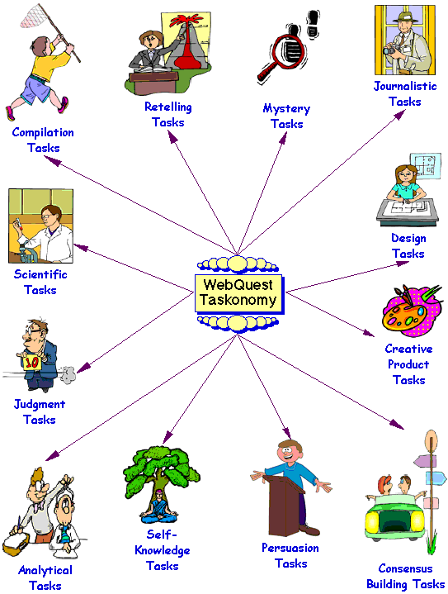

Slide 9
Bibliography
http://en.wikipedia.org/wiki/WebQuest
http://webquest.org/

